Slide 1
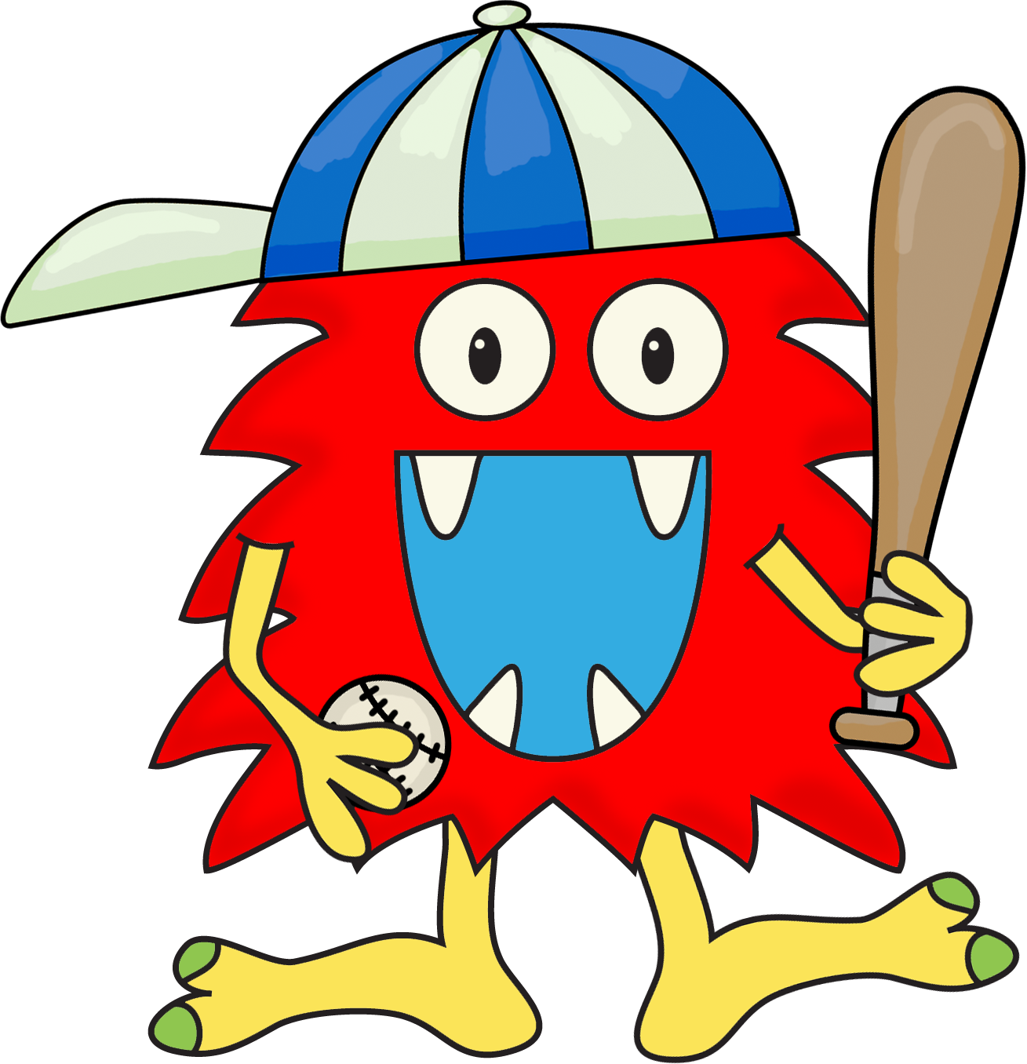
BASEBALL WORDS
Please play the slideshow and practice reading these high frequency words. Click on the little speaker if you do not know what it says.

Slide 2
we

Slide 3
the

Slide 4
I

Slide 5
you

Slide 6
was

Slide 7
for

Slide 8
to

Slide 9
a

Slide 10
said

Slide 11
and

Slide 12
do

Slide 13
like

Slide 14
go

Slide 15
see

Slide 16
is

Slide 17
have

Slide 18
little

Slide 19
can

Slide 20
play

Slide 21
are

