Slide 1
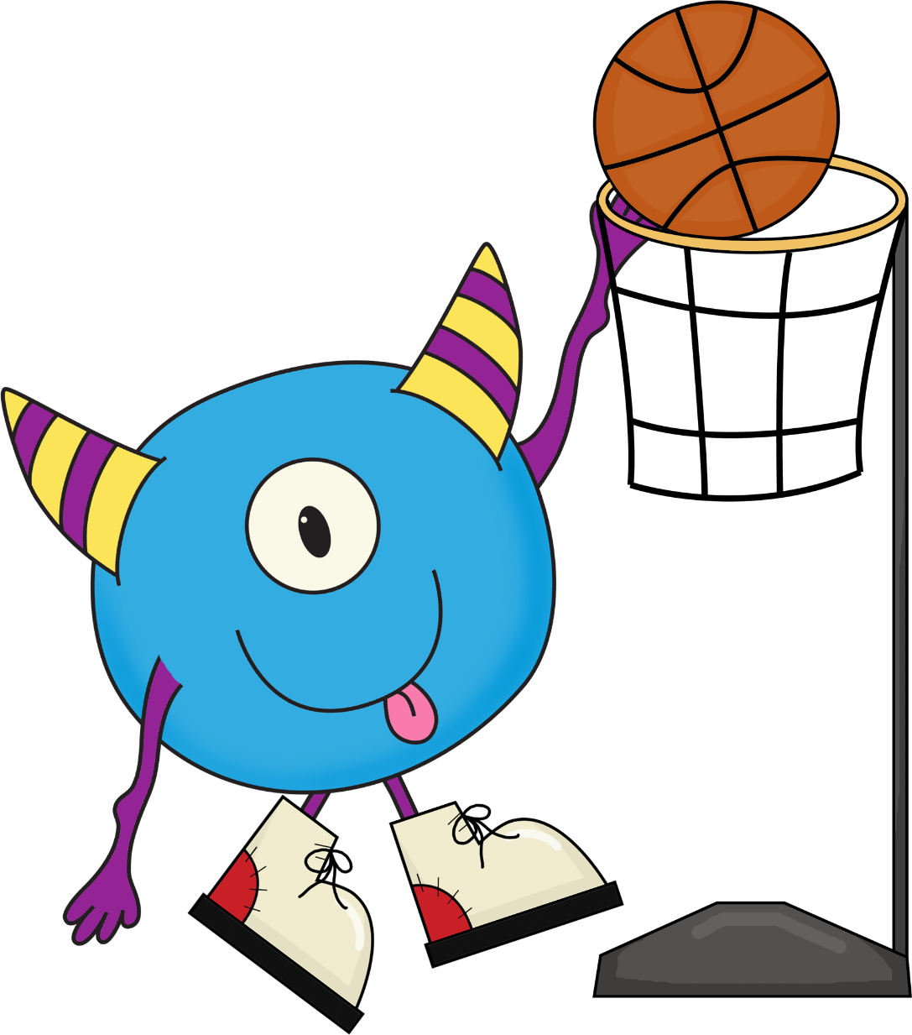
BASKETBALL
WORDS
Please play the slideshow and practice reading these high frequency words.
Click on the little speaker if you do not know what it says.

Slide 2
will

Slide 3
now

Slide 4
at

Slide 5
in

Slide 6
yes

Slide 7
not

Slide 8
on

Slide 9
did

Slide 10
am

Slide 11
Jump

Slide 12
big

Slide 13
make

Slide 14
so

Slide 15
ride

Slide 16
ran

Slide 17
over

Slide 18
as

Slide 19
get

Slide 20
very

Slide 21
it

