Slide 1
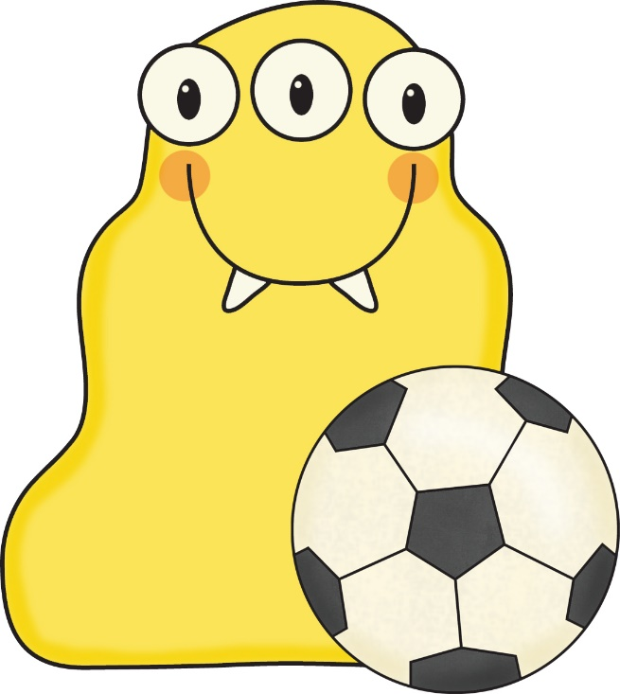
SOCCER BALL WORDS
Please play the slideshow and practice reading these high frequency words.
Click on the little speaker if you do not know what it says.

Slide 2
come

Slide 3
look

Slide 4
too

Slide 5
he

Slide 6
this

Slide 7
of

Slide 8
me

Slide 9
my

Slide 10
with

Slide 11
here

Slide 12
they

Slide 13
does

Slide 14
where

Slide 15
she

Slide 16
help

Slide 17
want

Slide 18
who

Slide 19
what

Slide 20
has

Slide 21
good

